Slide 1
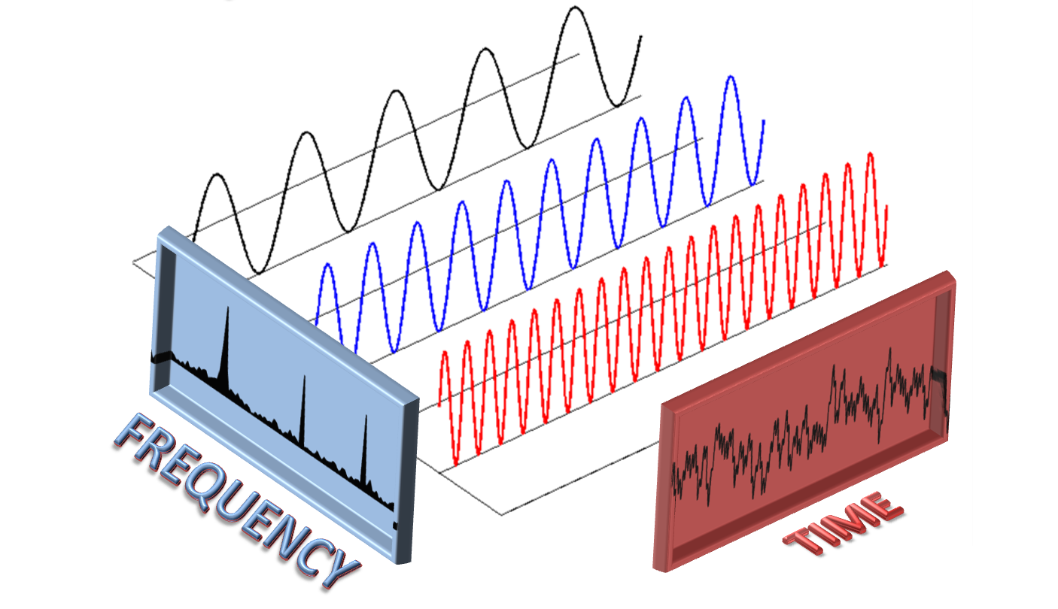
Digital Signal Processing
Hunter Garcia

Slide 2
What we will cover
Applications of DSP
Digital vs analog signals
Digital audio
DSP systems
Digital filters
Fourier transforms/Frequency domain
MATLAB and C

Slide 3
Why DSP?
DSP is used in….
Audio/Speech Processing
Image Processing
Audio/Video/Image Compression
Telecommunication
Biomedical
and more
Can be applied in both real-time systems and for “offline” analysis

Slide 4
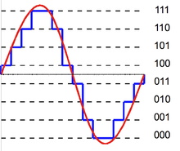
DSP Basics: digital vs analog signals
Analog signals – continuous in value and in time
Digital signals – discrete in value (bit depth) and in time (sample rate)
Bit depth & quantization – how many bits used to represent one sample of data. Most pro-audio uses at least 16 bits
Sample rate – how many individual samples of data in one second. Determines range of frequencies you can use: the highest frequency you can recreate is ½ the sample rate (Nyquist theorem).
44.1kHz – CD quality , 8kHz – telephone quality

Slide 5
Digital Audio
Frequency range (bandwidth) of human hearing: 20-20,000 Hz
Therefore, we typically want our sample rate to be greater than 2 x 20,000 according to Nyquist theorem
Commonly used: 44.1 kHz, 48 kHz, 96 kHz
Dynamic range of audio based on bit depth
Commonly used: 16 bits – gives us about 96 dB of dynamic range
Trade-off: memory & computation
Is there really an improvement in audio quality from 48 kHz to 96 kHz?

Slide 6
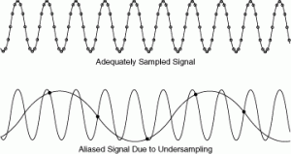
Digital signal representation errors
Quantization error
Low bit depth causes noise in audio
Surprisingly, you can still hear audio with only 1 quantization bit!!
Aliasing
If your sample rate is too low, high frequencies look like low frequencies
Quick fix: use a low pass “anti-aliasing” filter to remove high frequencies
Video

Slide 7
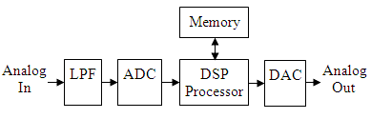
Typical DSP system

Slide 8
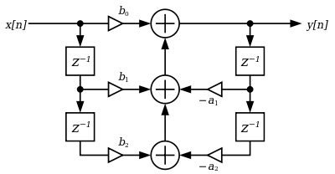
Digital Filters
What if we want to modify the frequency content of the audio?
We can use simple math (multiplies, adds and delay blocks) to implement all sorts of filters
High pass, Low pass, Band pass, Band stop
This is why DSP chips are specially suited for these kinds of operations
Where do they come from??

Slide 9
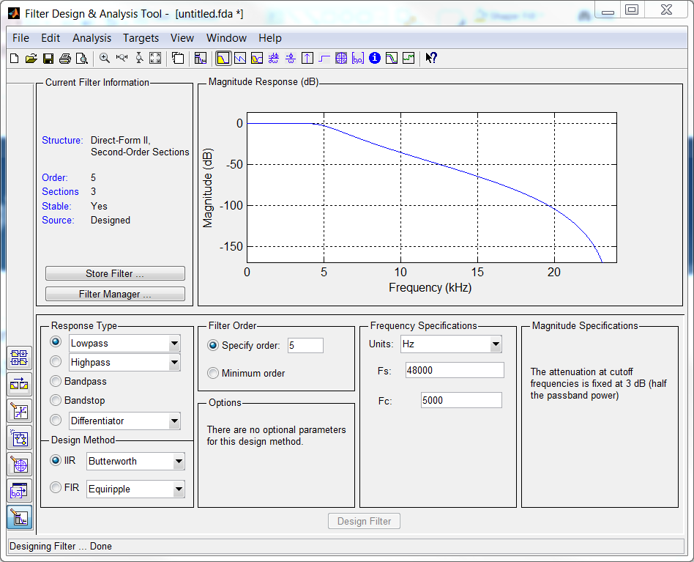
Digital Filter Design
Many methods to design, realize and implement a digital filter
MATLAB – fdatool
Can help with the steps involved in the design & realization of the filter
Pole-zero plots, transfer functions, Z-Transform
Complex math, its… complicated

Slide 10
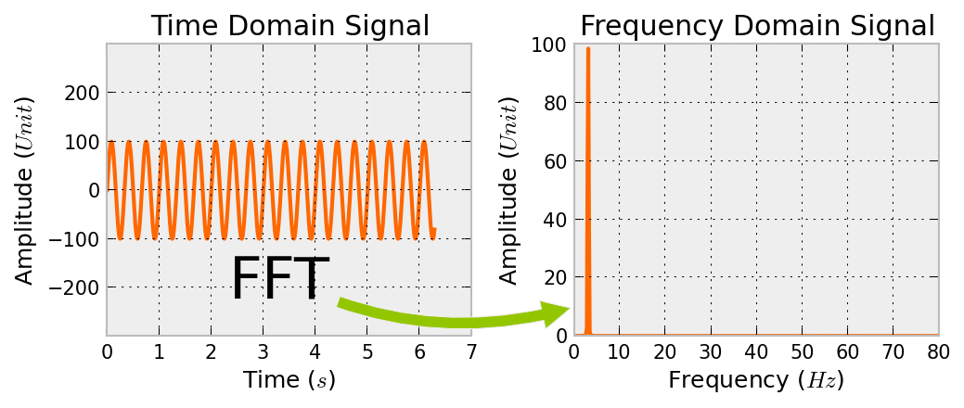
Time domain vs frequency domain
A lot of the time we want to analyze a time signal and find out what frequencies are contained within
Theory: all signals can be represented by a sum of sinusoids of various frequencies (with different phase & magnitude)
We can use the Fast Fourier Transform to analyze the frequency content
In MATLAB – fft() command takes in a time domain signal and gives is the frequency spectrum

Slide 11
How to code basic DSP?
MATLAB and C/C++ are your friends
MATLAB – Signal Processing Toolbox has many functions built-in to help prototype and test your DSP algorithms for offline use, as well as flexible graphical tools
C/C++ are relatively fast languages portable for implementation on real-time DSP systems & embedded chips.
Speed is desirable because you may be running your code over and over again on thousands of samples of audio a second
Common workflow:
Figure out math/theory behind your algorithm
Use MATLAB to test/prototype your algorithm
Convert from MATLAB to C
Test, evaluate, and optimize!

Slide 12
Q&A

